Slide 1
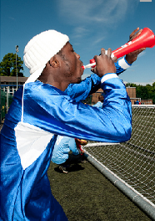
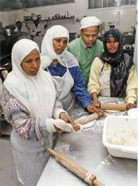
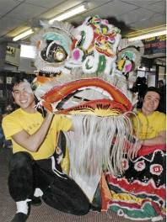
Changes in British Society 1955 – 1975: Immigration
Sheffield Archives and Local Studies: History Key Stage 4 GCSE
Images (L-R) copyright: Andy Greaves, Sheffield and Sheffield Local Studies Library: Picture Sheffield
Notes:
Some key outcomes from this presentation:
By using these local resources pupils will:
Understand Britain’s need for more workers after the Second World War and the growth in immigration
Appreciate the experience of immigrants in Sheffield from c.1955 to c.1975
Understand the challenges in race relations between c.1955 and c.1975
Understand the role of the Government in changing attitudes to immigration

Slide 2
What is immigration?
Migration is the movement of people from one place to another.
Emigration is when someone leaves a country.
Immigration is when someone enters a country.
The reasons for migration can be economic, social, political or environmental.
Migration usually involves push and pull factors.

Slide 3
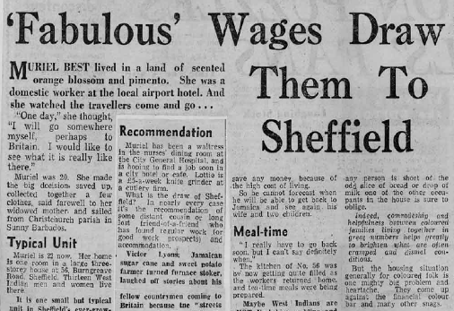
Reasons for migration
Some people choose to migrate, e.g. someone who moves to another country to increase their job prospects.
Pull factors include:
Better employment prospects
Greater wealth or affluence
Political stability
Improved safety
Better quality of life
Better service provision
Newspaper article from the Sheffield Star in the 1950s describes how ‘fabulous wages’ are attracting immigrants to Sheffield
Source: The Star, 1950s, Sheffield Local Studies Library

Slide 4
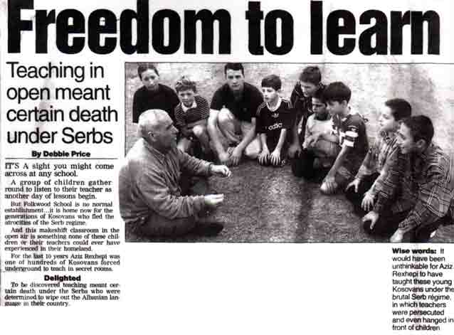
Reasons for migration
Some people are forced to migrate, e.g. someone who moves due to war or famine.
Push factors include:
Poverty
War
Flooding
Drought
High crime
Poor safety
Lack of services or opportunities
Newspaper article in the Sheffield Star shows children who fled the Kosovan War in 1998-1999 to live in Sheffield
Source: The Star, 1990s, Sheffield Local Studies Library

Slide 5
Different types of immigrants
A migrant worker is someone who moves to another country to find work.
An asylum-seeker is someone who is fleeing danger in their own country and who has applied to the authorities in another country to be accepted as a refugee.
A refugee is someone whose application for asylum has been successful and has been given permission to stay in the UK.
Many refugees and asylum-seekers have had extremely traumatic experiences and have had to leave their homes at very short notice.

Slide 6
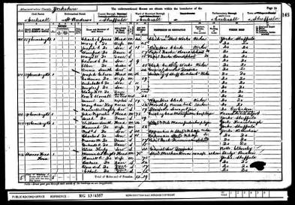
History of immigration in Sheffield
The 1950s saw a huge rise in immigration to Britain. However, most British cities have a long history of immigration.
For hundreds of years people have come from different parts of the world to make a new home in Sheffield.
Note some of the names from the 1881 and 1891 census in Sheffield:
Samuel Olewsky, tailor, 4 Grindle Gate
Louis Metzger, pork butcher, 98 West bar
Giovanni Ferarrio, glass carver and gilder, 17 Penley Street
John O’Donnell, boot and shoe maker, 41 Lambert Street
Can you guess from their surnames where these Sheffield people were originally from?
Source: Sheffield Census, 1881; 1891, Sheffield Archives and Local Studies Library

Slide 7
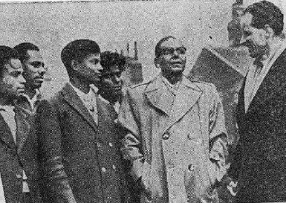
The beginnings of mass immigration to Sheffield
Irish: Irish immigration to Sheffield was first recorded in 1433.
Pakistani: Immigration began in the 1950s to meet labour shortages.
Indian: Immigration peaked in the 1960s.
Chinese: The first Chinese immigrants came in the late 1800s. After the Second World War many more came to Britain.
Bangladeshi: Began to arrive in the UK after 1945 to work in Sheffield factories.
African Caribbean: Most came to Sheffield during the labour shortages of the 1950s.
Immigrants pictured in Attercliffe, Sheffield in 1958
When did many new immigrants start to arrive in the UK and Sheffield?
Source: The Star, 1950s, Sheffield Local Studies Library
Notes:
Irish community. Irish migration to Sheffield was first recorded in 1433 and the Irish may be the oldest minority ethnic community in Sheffield. Many Irish immigrants came to Sheffield in the 1950s and 1960s in a response to a demand for labour in the building trade and the coal and steel industries.
Pakistani community. The Pakistani community is the second largest in Sheffield after the Irish. Immigration to the UK began in earnest in the 1950s when people were encouraged by the British Government to come to meet the labour shortages in the UK. The first immigrants were mainly male as they intended to earn some money and then return to Pakistan. Gradually they got used to Britain and decided to stay However many chose to settle permanently and brought their wives and families to live here, establishing a settled community.
Indian community. There have been Indians in Britain since the 17th century. The peak of immigration occurred in the 1960s. The Indian community in Sheffield originates from The Punjab, West Bengal and Gujarat areas of India. Some have emigrated from Uganda when Idi Amin expelled them from the country in the early 1970s, and some from Kenya. A few Indians in Sheffield are Tamils.

Slide 8
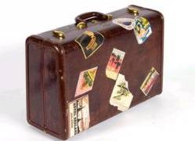
Why was there so much immigration into Britain in the 1950s?
Before the Second World War (1939 – 1945) there were very few black and Asian people in Britain although many black and Asian men from the colonies served in the British armed forces during the war.
After the Second World War, the 1948 British Nationality Act gave all 800 million people in the Commonwealth the right to claim British citizenship. This gave them the right to come and live in Britain – ‘the mother country’ – without restriction.
From the mid-1950s until 1961, 30,000 people a year emigrated from the New Commonwealth to Britain.
Restrictions on immigration from the Commonwealth were imposed in 1962.
Research: what was the significance of the Windrush ship for immigration to Britain after the Second World War?

Slide 9
Push and pull factors
Labour shortage By the 1950s Britain had a serious shortage of labour – especially for low-paid and unskilled jobs. Immigration offered a practical solution.
Encouragement
Many immigrants were given financial support to make the move including interest-free loans for travel.
Recruitment campaigns
British firms advertised for overseas workers:
National Health Service (NHS) formed in 1948 needed workers.
Northern textile companies recruited workers from India and Pakistan.
London Transport went to the Caribbean to find staff.
New opportunities
Working in Britain offered the opportunity to earn good wages. Many male immigrants aimed to work in Britain for a short time, sending money home, before returning themselves.

Slide 10
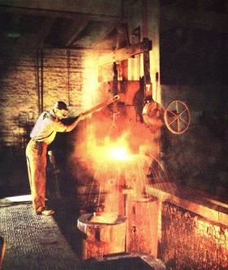
Why did people come to Sheffield in the 1950s and 1960s?
Sheffield was a major industrial city until the 1980s so the earlier arrivals came here to find work, particularly in the steel industry.
Large-scale immigration started in Sheffield later than in many other cities.
WHY? Economic growth was slower after the war than elsewhere.
The rate of growth of immigration was slower than elsewhere.
WHY? Fewer consumer manufacturing industries of the sorts that generated labour demand elsewhere.
The composition of immigrants was unusual.
WHY? Less large-scale recruiting, either by companies or the public sector.
Steelmaking in Sheffield, 1950s
Source: FOX collection, Sheffield Archives

Slide 11
1951 census of Sheffield
The census collects and records information about the population. The 1951 census for Sheffield recorded:
2535 born in Ireland
1206 born in Poland
665 born in Germany
587 born in India
78 born in Pakistan
32 born in Jamaica
Small number of Somalis
A Jewish population
Pakistan
Jamaica
India
Where did most of Sheffield’s immigrants come from in the 1950s?
Source: Migration and Diversity in Sheffield: Past, Present and Future, Prof. Paul White, University of Sheffield, 2006

Slide 12
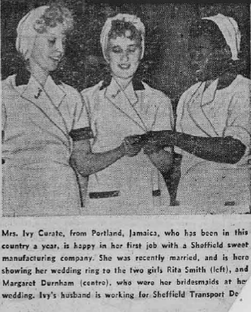
The experience of immigrants, 1955 - 1975
Newspaper reports in the 1950s highlight examples of integration in Sheffield.
Source: The Star, 1950s, Sheffield Local Studies Library

Slide 13
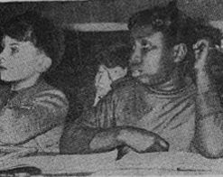
Employment and education
“Growing up together – nine year old Yvonne Browne from Jamaica, who lives in Scott Road, enjoys her lessons at Firs Hill County Junior School.” (The Sheffield Star, 1958)
“Working on the buses – these coloured conductors enjoy a brief rest in Castlegate before beginning their next journey.” (The Sheffield Star, 1958)
Source: The Star, 1950s, Sheffield Local Studies Library

Slide 14
Racial tensions
For many immigrants, Britain was not as welcoming as they had expected. Those migrating to Britain often settled in poorer inner-city areas. White people started to move out and by 1957 the government was concerned about ‘white-flight’ and ‘segregation’ in some of Britain’s major towns and cities. Tensions developed within white working class communities.
Unions complained that immigrants were taking jobs from white people by accepting lower wages.
Some politicians and members of the public argued that many immigrants were coming to Britain, not to work, but to receive generous welfare benefits.
Tensions also developed about education and housing.
Source: The Star, 1950s, Sheffield Local Studies Library

Slide 15
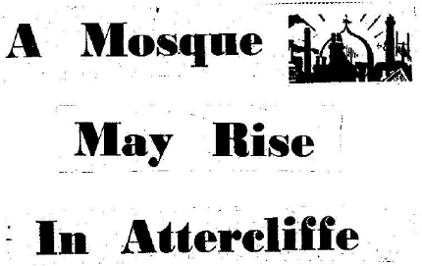
Problems in Sheffield
Newspaper reports from Sheffield in the 1950s reveal the worries many had about immigration.
“Now there is BEWILDERMENT – even FEAR on the part of residents”.
“A crack doing the rounds in Attercliffe these days runs like this: ‘I was walking along Attercliffe Common and I saw a white man’.”
“Rugged Attercliffe people are not the type to worry about such things as colour bar problems but a situation is arising which I found at least bewildering to many.”
Source: The Star, 1950s, Sheffield Local Studies Library

Slide 16
Growing social unease
Many of the early immigrants were young men without their families in Britain. This led to:
A culture of drinking in bars and clubs.
Attacks on immigrants by white working class ‘Teddy Boys’.
Graffiti appealing to ‘Keep Britain White’.
Sensational newspaper reports about the supposed lack of cleanliness, criminal activities and sexual practices of immigrants in Britain.
In 1956 and 1958, Mr Bingham of Sheffield Council of Social Service wrote to the Secretary of State requesting a Colonial Office Welfare Officer to help with inter-racial community work.
Sources: The Star, 1950s, Sheffield Local Studies Library; PRO/CO1031/2540, www.movinghere.org.uk

Slide 17
Contemporary voices
The increasing numbers of Asian immigrants settling in Britain faced additional problems:
They often spoke a different language and did not understand English which made the search for jobs difficult.
They often practiced different religious customs such as arranged marriages and fasting. This excluded them from many social activities.
This meant Asian immigrants were more likely to set up their own businesses. They also bought cheap property to rent out to other immigrants.
Audio file: Mr Y, Tinsley
What do this interview clip suggest about race relations in Sheffield?
Source: Oral history collection, (cassettes 18) Sheffield Local Studies Library

Slide 18
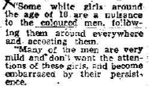
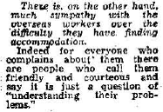
What was the immigrant experience?
The experiences of many immigrants were often very different:
Some were highly educated but were forced to take on low-skilled employment as their qualifications were not recognised in Britain.
Many found themselves sharing overcrowded, poor quality housing.
They were discriminated against, with signs appearing for accommodation and jobs stating ‘No coloureds’ and ‘No blacks’.
Source: The Star, 1950s, Sheffield Local Studies Library

Slide 19
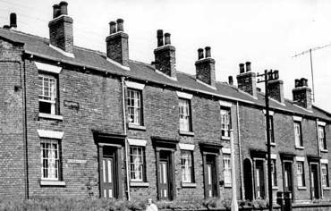
On housing in Sheffield
Extracts from interviews with the Kelvin Caribbean Lunch Club, Sheffield:
“I lived in Brunswick Street, Broomhall. It was terrible. The digs they were shocking, indescribable. It didn’t matter how big your family was, you had to live in one room. It was cold and damp – we ended up in the worst housing. It’s terrible what we leave behind – my home in Barbados was lovely…”
Terraced housing in Burngreave, Sheffield, 1965
“The first black man that came to Sheffield bought a house, then all the black people that came here get packed into that house. One lot of people work all night and another lot in the days, and you share a bed. That was awful really, because when you were at home it was not only family that slept together but strangers.”
Source: Taste the roughness: Kelvin Caribbean Lunch Club talking memories, 1991, Sheffield Local Studies Library: 325.1 S

Slide 20
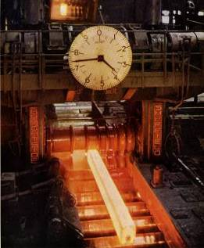
On finding work in Sheffield
Extracts from interviews with the Kelvin Caribbean Lunch Club, Sheffield:
“I was working at the rolling mill at Hadfield’s at Vulcan Road. I was the one coloured man and they do give me a hard time. They don’t want no coloured man in that mill. The man in front gave me the steel awkward so that if I ever missed it, it was coming right on me so that I could have been burned up or something. He gave it me awkward because he wanted me to get browned off so I’d leave the job. But I survived! I paid a high price for it but I came out on top.”
Firth Brown steelworks, Sheffield, 1950s
“I was working on the stroke unit [at the hospital] with a lot of oldish people. Sometimes the old people came in and said ‘we don’t want no black body to touch us, all right?’ The Sister would come (she was white) – she say to them ‘she is working for us and if you don’t want her, you don’t want us’.”
Source: Taste the roughness: Kelvin Caribbean Lunch Club talking memories, 1991, Sheffield Local Studies Library: 325.1 S

Slide 21
On living and socialising in Sheffield
Extracts from interviews with the Kelvin Caribbean Lunch Club, Sheffield:
“My husband and friends went out to a pub in Attercliffe and called for a drink. They took back the glasses and saw the bar manager break all four glasses. They didn’t say nothing. When they returned their glasses after the second drink the same happened. After the third drink they broke their own glasses and threw them in the bin and the manager called the police. The policeman says ‘you better go and find yourself another pub’.”
Books compiled to record the experiences and memories of first generation Sheffield immigrants.
“I didn’t care what colour his skin was. You see I’m white, but my husband is coloured. Years ago we went for a drink, just in the dinner time. We were asked to leave – ‘we don’t allow no black men in here’ they said. We had to get up and go.”

Slide 22
The Notting Hill race riots, 1958
Tensions came to a head in Britain in 1958 when there were serious race riots in both Nottingham and London. The Notting Hill riots in London received widespread media coverage.
In Notting Hill, West London by the 1950s there was a strong Caribbean community.
Over two weeks in August 1958, hundreds of young white men attacked immigrants with chains, knives and petrol bombs.
More than 100 white men were arrested as well as some black men who had armed themselves in self-defence.

Slide 23
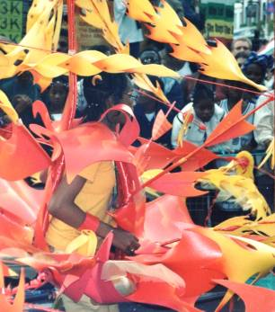
Aftermath of the riots
The Notting Hill riots were a turning point in Britain’s immigration history:
4,000 immigrants returned to the Caribbean.
The Caribbean governments made an official complaint to the British government.
Public and political opinion became divided.
Immigrant groups in Britain organised themselves into official groups to protect their interests.
Debate increased about the extent of immigration into British inner cities and how to deal with racism.
The first Notting Hill Carnival was organised in 1959 by Claudia Jones in response to the riots that had happened the previous year.
Source: Notting Hill Carnival, 2000 (copyright: Sheffield Archives staff)

Slide 24
Debate and discussion: the immigration question is raised
After the Notting Hill riots, the British government was faced with two main issues:
The number of immigrants entering Britain
Ways of tackling racial discrimination
The immigrant experience of Britain’s key cities, including Sheffield, was debated in 1958:
“The recent wave of immigrants coincided with a fall in employment in Sheffield, and for most of these immigrants there have been, and still are, no jobs.”
“I heard charges of discrimination against coloured people in labour exchanges.”
“There have been cases of young hooligans coming into the district with bicycle chains looking for coloured people to attack.”
“More should be done at the [other] end to inform potential immigrants of conditions and openings available in the UK.”
“Earlier than eighteen months ago there was, in fact, no colour problem whatever in Sheffield.”
Extracts from the House of Lords debate on colour prejudice and violence, 1958
Source: HL Deb 19 Nov, 1958 (Hansard)

Slide 25
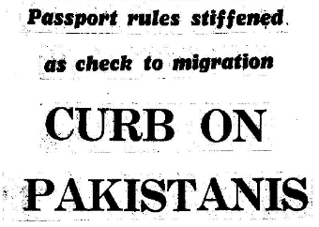
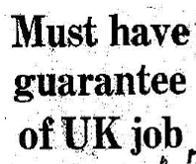
Controlling the numbers
In 1961 there was a sudden increase in immigration to Britain. This was partly due to fears that the British government was preparing to limit the numbers allowed into the country.
Newspaper reports in the Sheffield Telegraph from the late 1950s/early 1960s reflect the growing pressure on the government to restrict immigration.
Source: The Sheffield Telegraph, 1950s – 1960s, Sheffield Local Studies Library

Slide 26
Laws to control immigration
Commonwealth Immigrants Act 1962 – meant that immigrants from the former British colonies had to have a pre-arranged job before entering Britain, or have special skills required by the British economy.
Commonwealth Immigrants Act 1968 – tightened controls further. Immigrants now needed to have a parent or grandparent who had been born in Britain.
Primary immigration: when someone moves to Britain alone.
Secondary immigration: if members of their family later join them.
Immigration Act 1971 – meant that only 12-month work permits were issued so that immigrants could only remain in Britain for a limited time. By the early 1970s, Britain had virtually stopped all black and Asian primary immigration.

Slide 27
Political opposition to immigration
British Union of Fascists – set up by Oswald Mosley in 1932. The party campaigned against immigration in 1959 but gained little support.
1964 general election – the Conservative MP for Smethwick, West Midlands, Peter Griffiths defeated Labour with the slogan ‘if you want a nigger for a neighbour vote Labour’.
National Front party – formed in 1967, the party was firmly opposed to immigration, improved race relations or multiculturalism. It had 20,000 members by the mid-1970s although its existence had largely diminished by the late 1970s.
Enoch Powell – the Conservative MP made his ‘Rivers of Blood’ speech in 1968 calling for an end to all non-white immigration and the introduction of voluntary repatriation.
See the short film ‘Anti National Front protest in Bradford’ (1978) at www.yfaonline.com

Slide 28
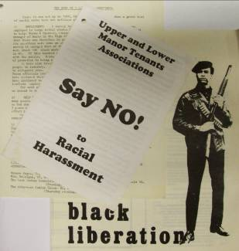
Dealing with racism
Government policies were introduced to deal with racism.
Race relations legislation was passed in 1965 which led to the establishment of the Race Relations Board.
The Race Relations Act 1968 made the following provisions:
The Campaign Against Racial Discrimination (CARD) was set up in 1964 which lobbied for race relations legislation. The group lasted until 1967.
Discrimination in housing and employment banned.
The use of restrictions such as ‘no coloureds’ were banned.
Incitement to racial hatred banned
Source: Sheffield Archives: X421

Slide 29
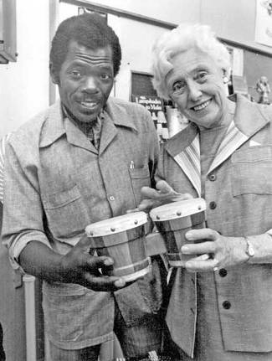
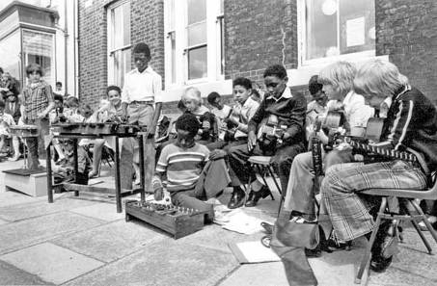
Multiracial Sheffield by the mid-1970s
By the mid-1970s there was greater integration between white people and immigrants. Second generation, British-born immigrants started to attend British schools and adopting British culture.
This brought its own issues – first generation immigrants often felt their children were losing touch with their roots.
Events such as ‘West Indian Fortnight’ at Burngreave Library, Sheffield in 1977 aimed to promote greater understanding of different cultures.
Source: Sheffield Local Studies Library: Picture Sheffield

Slide 30
What have you learnt?
Although the Race Relations Acts of the 1960s did not stop racism, this official government statement on the values of British society moved Britain a step closer towards a multicultural society.
To what extent do you think Britain was becoming a society where different races could live together harmoniously by the 1970s?
How much do you think the issue of race changed in Britain between the mid-1950s and the mid-1970s?
Mark two columns on a piece of paper one headed ‘Race relations in 1955’ and the other ‘Race relations in 1975’. List the changes in race relations that have taken place during this 20-year period.

Slide 31
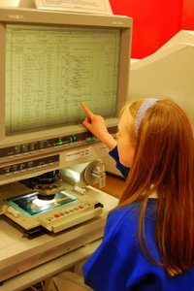
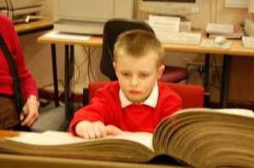
Sheffield Archives and Local Studies
If you would prefer to use this presentation as the basis for a class visit to Archives and Local Studies or in a visit by us to your class please contact us. Students will have the opportunity to see and touch the original items.
We offer:
Access to original primary source material from Tudor times through to the 21st century.
Class visits to the Central Library and to Sheffield Archives.
Visits to schools to deliver classroom sessions.
Introductory sessions for teaching staff.
Online PowerPoint lesson resources.
Focus Packs of colour facsimiles linked to the National Curriculum.
www.sheffield.gov.uk/archives

